Slide 1
The TPP A Tough Political Proposition (aka the Trans-Pacific Partnership)
Alan V. Deardorff
Ford School Tuesday Lunch
October 4, 2016

Slide 2
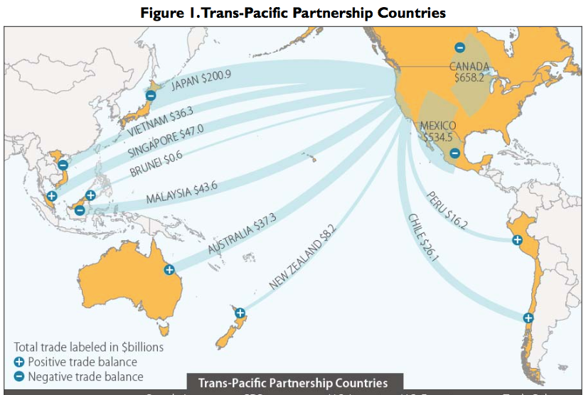
X?

Slide 3
What Is the TPP?
Main Features of TPP (only a few of 30 chapters):
Trade in goods: Reduce/remove tariffs & NTBs
Trade in services: Reduce/remove barriers
Digital trade: Facilitate data flows and E-commerce
Investment: Investor/State Dispute Resolution
Intellectual property: Expanded patents, etc.
Labor: Enforcement of standards
Environment: Enforcement of standards
State-owned firms: Competitive neutrality
Currency manipulation? (No, but side agreement)

Slide 4
Oddities of the TPP
Tariffs
Cars and trucks: US tariffs removed
Cars: 2.5%, removal phased in over 25 years.
Trucks: 25%, removal phased in over 30 Years.
Schedules and rates differ by exporting country

Slide 5
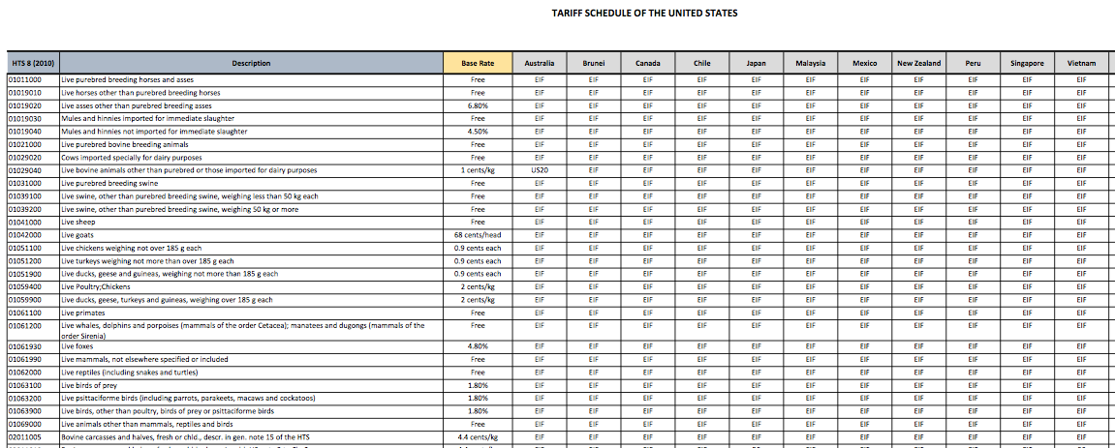

Slide 6
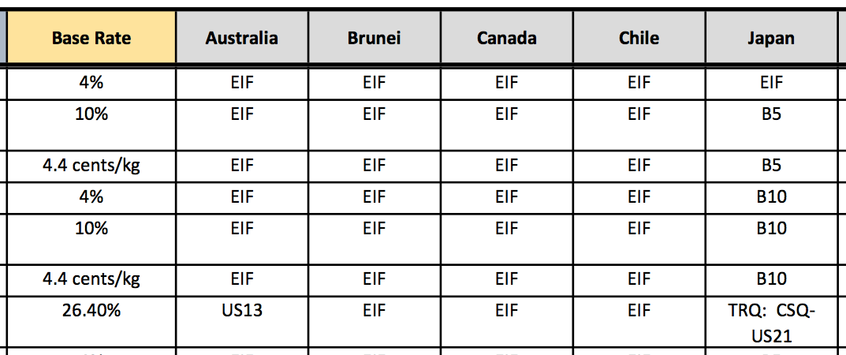
EIF: Entry In Force (duty-free from start)
B5: Eliminated in 5 annual stages, duty-free in year 5
B10: Eliminated in 10 annual stages, duty-free in year 10
Bovine Meat Cuts (i.e., Beef)
US21: No higher that Peru FTA
US13: Base rate until 2022; duty-free in 2022

Slide 7
Oddities of the TPP
ISDS: Investor/State Dispute Resolution
Controversial
Gives foreign companies rights that domestic companies lack
Solution: Does not apply to tobacco industry
(Implication: Tobacco companies won’t support TPP)

Slide 8
Oddities of the TPP
Biologic Drugs
(advanced medicines made from living organisms)
The issue: Time period of permitted data exclusivity
US wanted 12 years of protection, as contained in the Obama Care.
Australia and others wanted much shorter protection, 5 or 6 years.
Compromise: US keeps 12-years; others will not. 5 years protection will be an increase.
(Implication: Drug companies may not support TPP)

Slide 9
Oddities of the TPP
Japanese Agriculture:
Japan will lower its tariff on beef from over 38.5% to 9% over 16 years
Rice (no cut in tariff): New duty-free quota of 50,000 tons, rising to 75,000 tons in year 13

Slide 10
Oddities of the TPP
Exchange Rates
US wanted TPP to address currency undervaluation (which makes exports cheaper)
Resolution: Side Agreement on Exchange Rates:
Commitment to avoid manipulation
Transparency and Reporting
Group to meet at least annually to discuss macroeconomic and exchange rate issues
No enforcement mechanism

Slide 11
Should TPP be Approved?
Is it a good agreement?
Much of it is good
Reduces trade barriers
Harmonizes rules on health, safety, etc.
Broadens Rules of Origin
Some parts are bad (ISDR, IP)
But not as bad as I feared

Slide 12
Should TPP be Approved?
Is it a good agreement?
Will it hurt workers?
Some yes, just as NAFTA did
Provisions for labor standards are present but weak
Answer is not to reject TPP, but to accompany it with
Better Trade Adjustment Assistance
Wage Insurance
(And not just for workers dislocated by trade)

Slide 13
Should TPP be Approved?
Would rejection of TPP be bad?
Yes, hugely!
It will signal US withdrawal from the liberal trading system
It will tell TPP members that we are not on their side
It will encourage China to move ahead with its own trading block:
RCEP: Regional Comprehensive Economic Partnership (16 Asian countries)

Slide 14
Will TPP be Approved?
Maybe not:
TPP
Has not yet been ratified by any country
US
Will not consider in Congress until after November election, if then
TPP is opposed by Trump, Clinton, and much of the electorate
If TPP is voted down by US, it will die

